Slide 1
Image Processing
Lecture 4
Introducing Image Processing

Slide 2
Image Enhancement
in the Spatial Domain

Slide 3
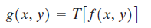
Background
The term spatial domain refers to the aggregate of pixels composing an image.
Spatial domain methods are procedures that operate directly on these pixels. denoted by
where f(x, y) is the input image, g(x, y) is the processed image, and T is an operator on f, defined over some neighborhood of (x, y).

Slide 4
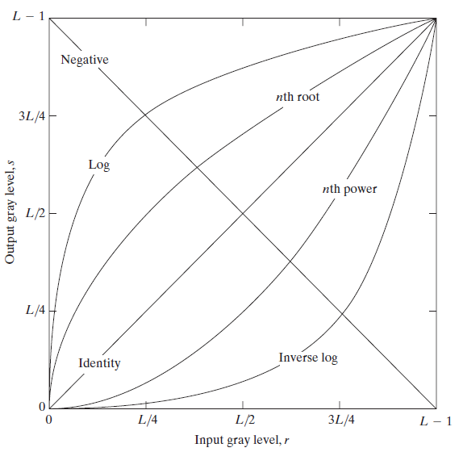
Some Basic Gray Level Transformations
Image Negatives : The negative of an image with gray levels in the range [0,L-1]is obtained by: s = L – r - 1

Slide 5
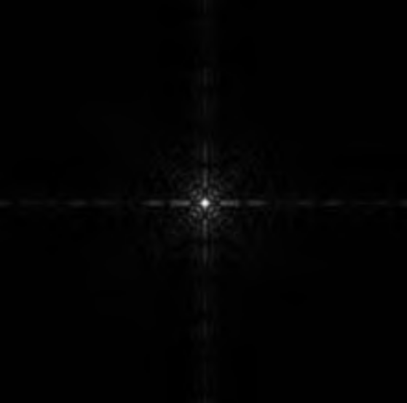
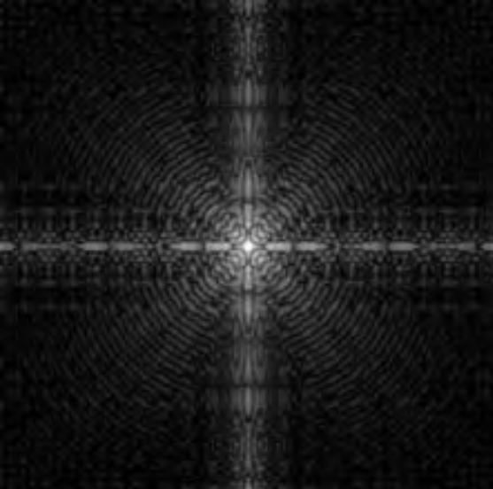
Some Basic Gray Level Transformations
Log Transformations : maps a narrow range of low gray-level values in the input image into a wider range of output levels.
s = c log (1 + r)

Slide 6
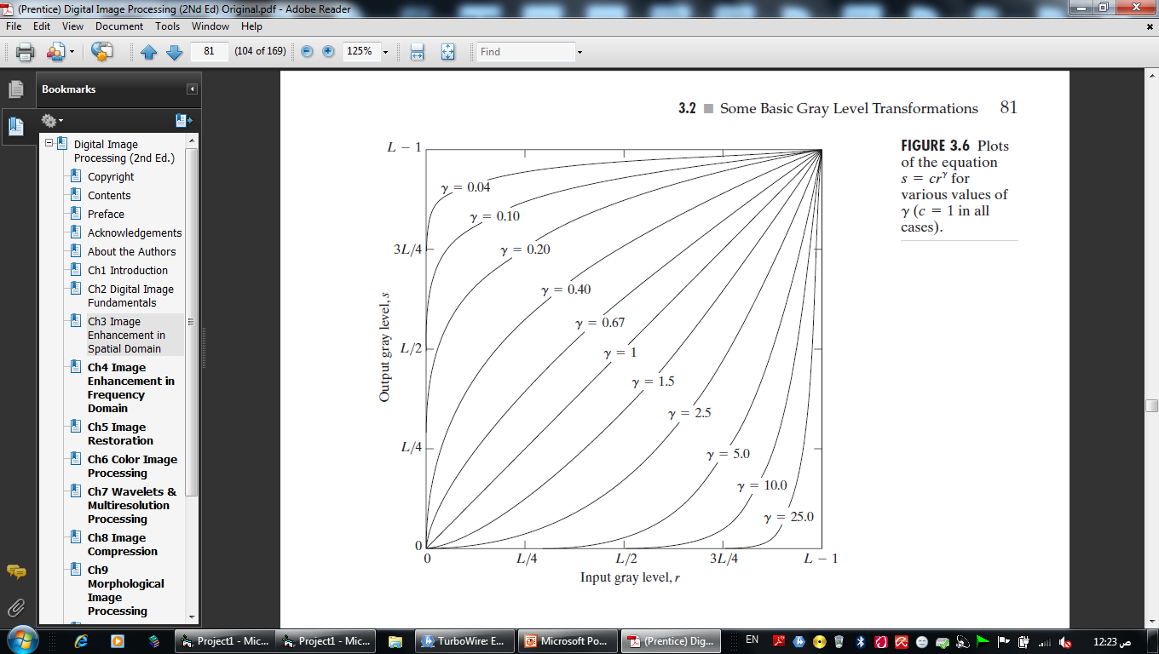
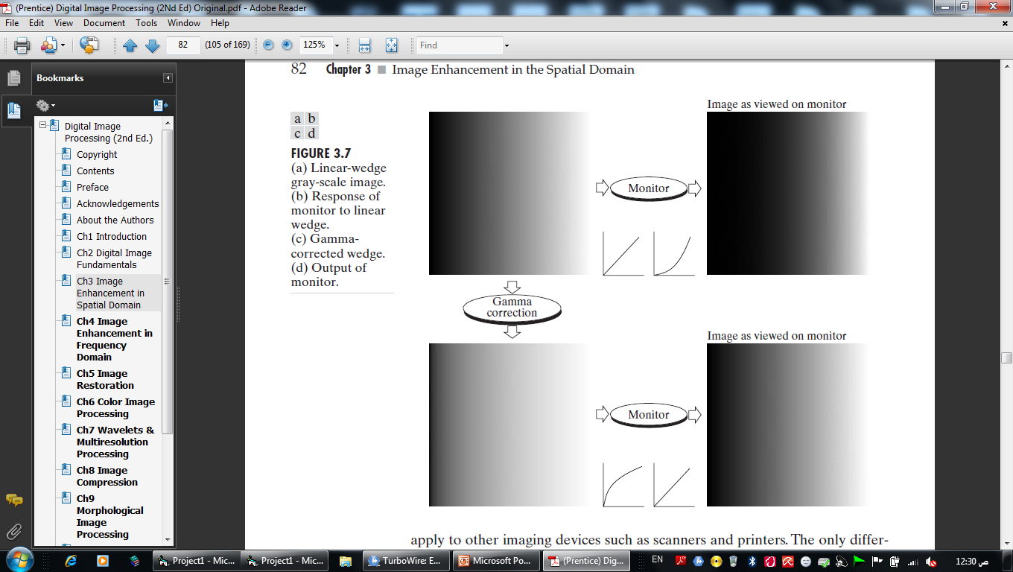
Some Basic Gray Level Transformations
Power-Law Transformations : map a narrow range of dark input values into a wider range of output values. s = cr^{g} gamma correction

Slide 7
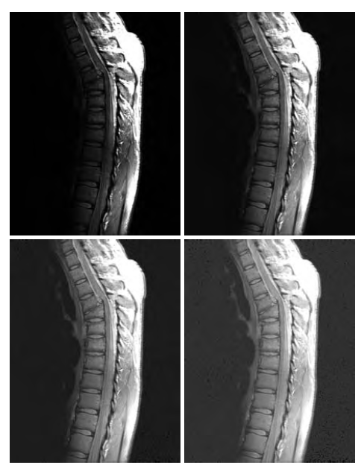
s = cr^{g}
C = 1
g = 0.6
0.4
0.3

Slide 8
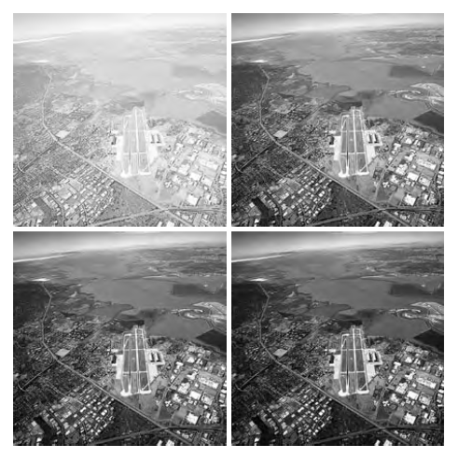
s = cr^{g}
C = 1
g = 3.0
4.0
5.0

Slide 9

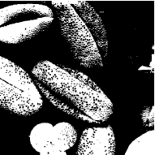
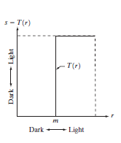
Piecewise-Linear Transformation Functions
Thresholding : In this transformation, the pixels are categorized in a specific manner into categories and each category has its own gray level

Slide 10
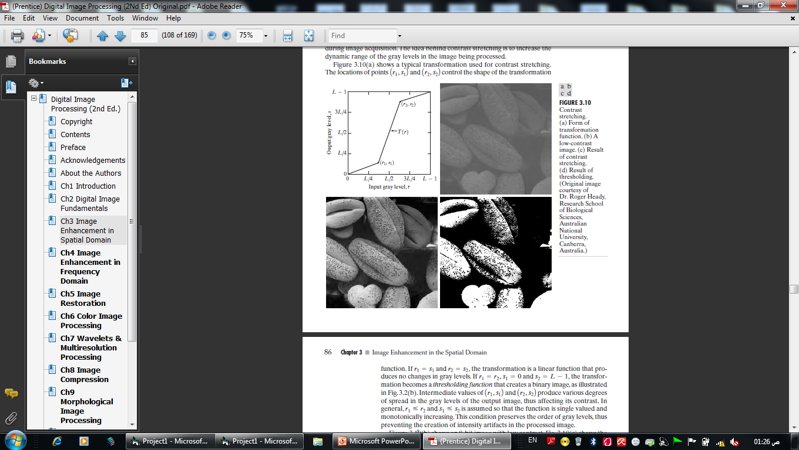
Piecewise-Linear Transformation Functions
Contrast stretching : The idea behind contrast stretching is to increase the dynamic range of the gray levels in the image being processed
Intermediate values of r1, s1 and r2, s2 produce various degrees of spread in the gray levels of the output image, thus affecting its contrast

Slide 11
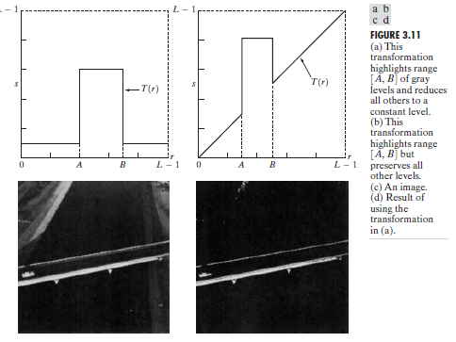
Piecewise-Linear Transformation Functions
Gray-level slicing: is a Highlighting of a specific range of gray levels in an image and it often is desired for applications include enhancing features

Slide 12
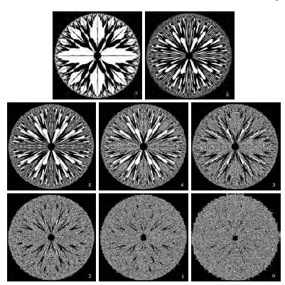
Piecewise-Linear Transformation Functions
Bit-plane slicing : Instead of highlighting gray-level ranges, highlighting the contribution made to total image appearance by specific bits might be desired.

Slide 13
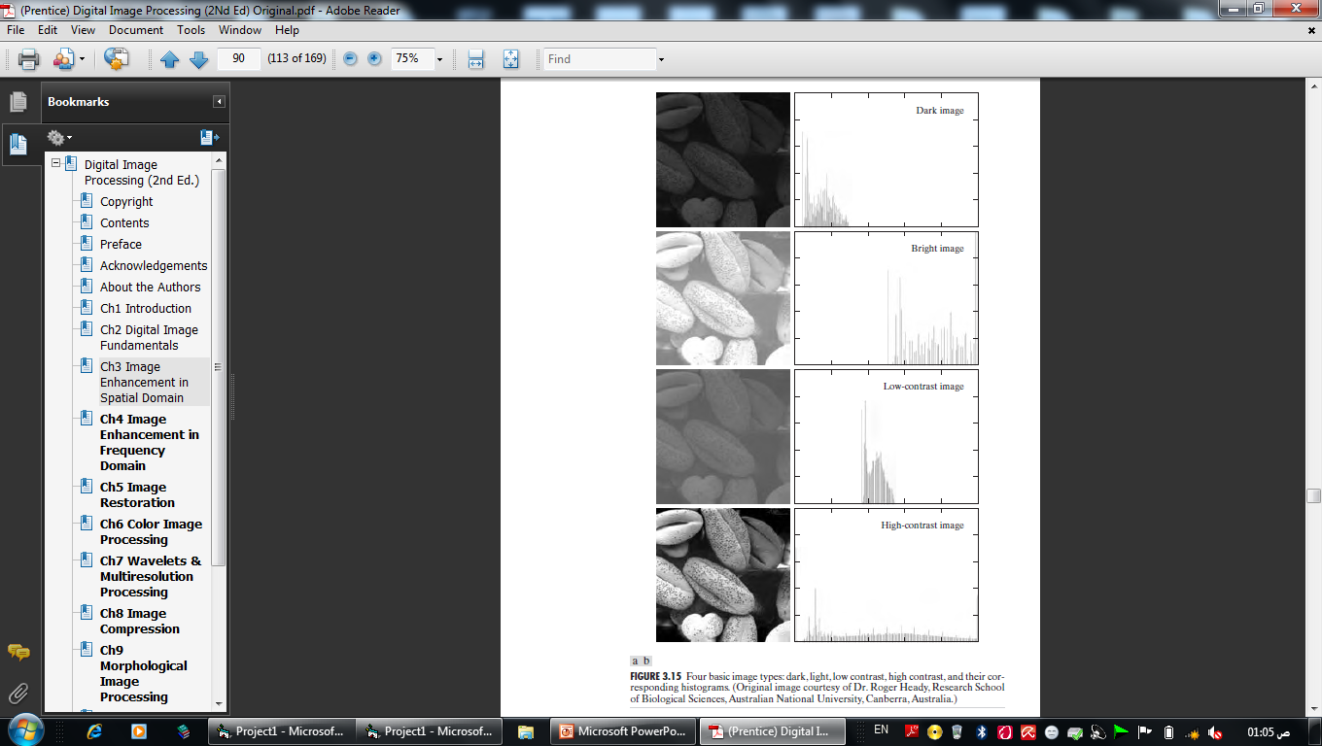
Histogram

